Slide 1

Richard Meadows 12688825 Research Proposal Research Methods and Professional Practice MSc Cyber Security University of Essex (Online) November 2022 Sports Talent Identification Using Cloud Computing

Slide 2
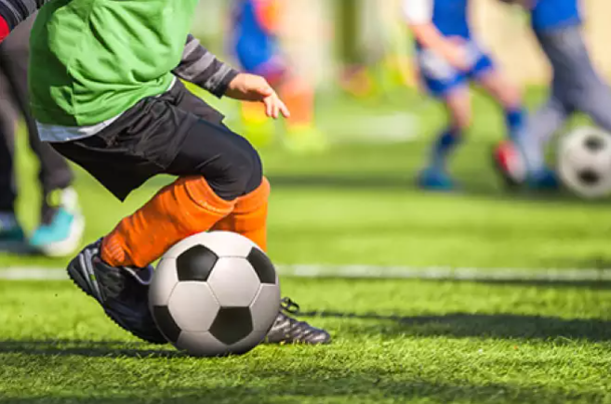
Introduction
Figure 1: Talent stock photo (Grove, 2016)

Slide 3
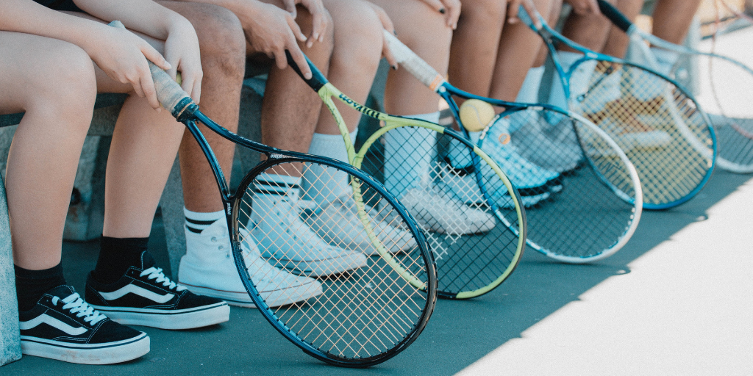
The Current State of Talent Identification
Figure 2: Development stock photo (Van der Stichelen, 2020)

Slide 4
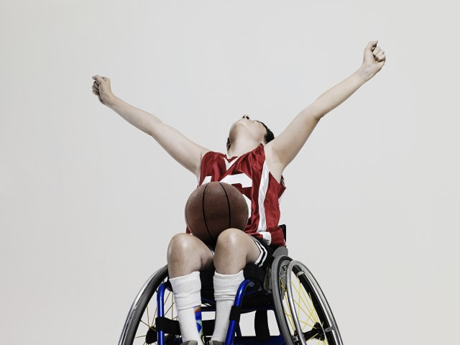
The Current State of Talent Identification
Figure 3: Goals stock photo (Get Set, N.D.)

Slide 5
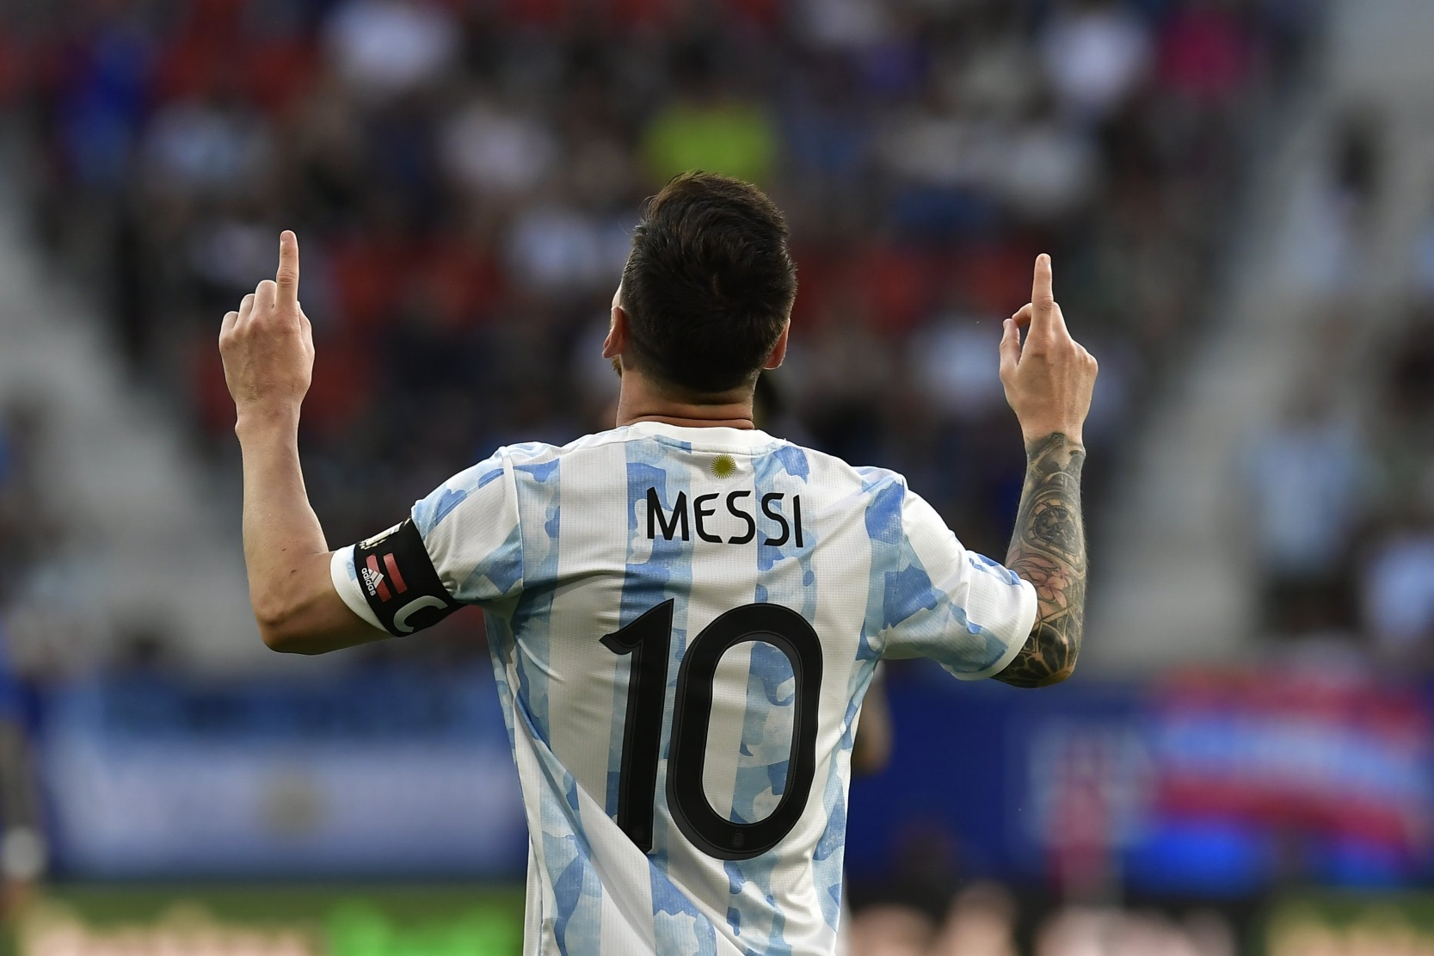
Figure 4: Messi stock photo (Daily Sabah, 2022)

Slide 6
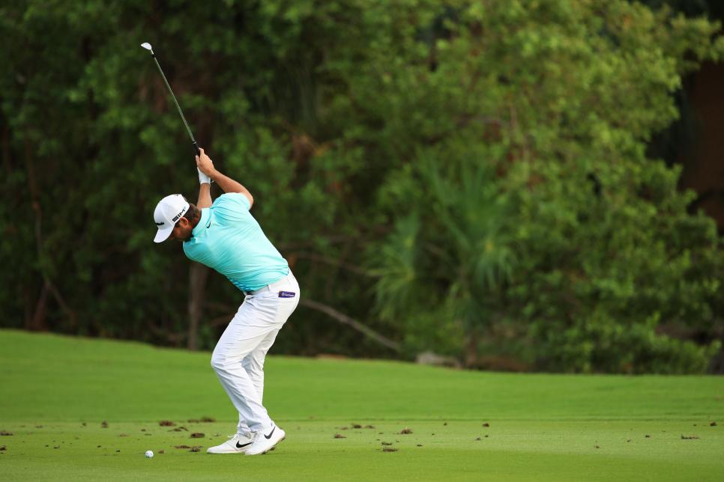
Figure 5: Woolf stock photo (Rapaport, 2021)

Slide 7

The Use of Cloud Computing in Talent Identification
Figure 6: Cloud stock photo (Merlicek, 2021)

Slide 8

Research Question
Figure 7: Question stock photo (Polishuk, N.D.)

Slide 9
Research Question
How can cloud computing be used to identify sporting talent?
How can cloud computing be used to identify talent in nine year old children?
Can the same model identify undiscovered potential talent in others?

Slide 10
Aims and Objectives
Aim:
To explore cloud technology’s ability to predict future high performing athletes based on expert knowledge and empirical data inputs
Objectives:
Determine, based on historical data and expert opinion, which factors contribute as indicators of athletes being successful in sport
Using cloud computing, analyse the data to produce meaningful results
Discover if the model is transferrable for both children aged nine and hidden gems

Slide 11

Methodology
Figure 8: Methodology stock photo (Thattamparambil, 2020)

Slide 12

Methodology
Figure 9: Research stock photo (Tooley, 2015)

Slide 13
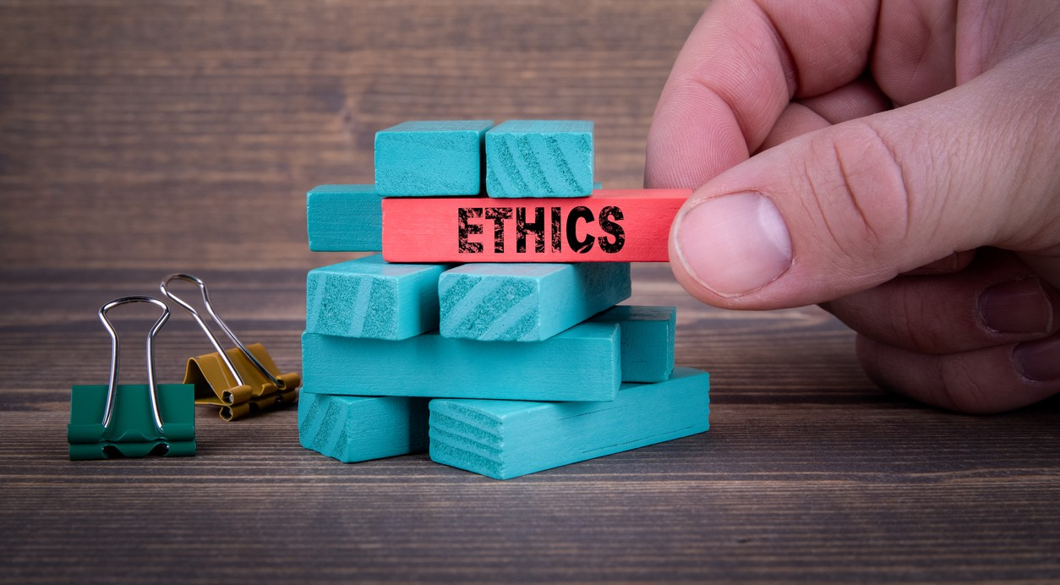
Ethical Considerations and Risk Assessment
Figure 10: Ethics stock photo (Sherpa, N.D.)

Slide 14
Timeline of Activities
Table 1: Timeline of activities
Task | Duration
Literature search | 4 days
Literature review | 3 days
Analyse and evaluate | 2 day
Complete presentation and transcript | 3 days
Thank you

Slide 15
References
Abbott, A., Button, C., Pepping, G., Collins, D. (2005) Unnatural selection: Talent identification and development in sport. Nonlinear Dynamics Psychology and Life Sciences 9(1): 61-88. Available from: https://www.researchgate.net/publication/8102048_Unnatural_selection_Talent_identification_and_development_in_sport
Athletics Training. (N.D.) Talent Identification. Available from: http://www.athletics-training.com/articles/talent-identification.html [Accessed 22 November 2022].
Berenson, M. L., Levine, D. M., & Szabat, K.A. (2015) Basic Business Statistics: Concepts and Applications. 3rd ed. Harlow: Pearson Education. Available from: https://web-s-ebscohost-com.uniessexlib.idm.oclc.org/ehost/ebookviewer/ebook/bmxlYmtfXzE0MTk1NDVfX0FO0?sid=511d3386-00e8-4ae9-8f70-de466e9d4c89@redis&vid=0&format=EB&rid=1 [Accessed 24 November 2022].
Brefeld, U. & Zimmermann, A. (2017) Guest editorial: Special issue on sports analytics. Data Mining and Knowledge Discovery volume 31(6): 1577–1579. DOI: https://doi.org/10.1007/s10618-017-0530-1
Carroll, W. (2013) Lionel Messi and HGH: The Truth About the Best Footballer in the World. Available from: https://bleacherreport.com/articles/1492546-lionel-messi-and-hgh-the-truth-about-the-best-footballer-in-the-world [Accessed 23 November 2022].
Coalter, F. (2005) The Social Benefits of Sport. Glasgow: SportScotland.
Dittrich, D. & Kenneally, E. (2012) The Menlo Report. IEEE Security & Privacy 10(2): 71-75. DOI: https://doi.org/10.1109/MSP.2012.52
European Club Association. (2012) Report on Youth Academies in Europe. Available from: https://www.ecaeurope.com/media/2730/eca-report-on-youth-academies.pdf [Accessed 25 November 2022].
Jauhiainen, S., Äyrämö, S., Forsman, H. & Kauppi, J.P. (2019) Talent identification in soccer using a one-class support vector machine. International Journal of Computer Science in Sport 18(3): 125-136. DOI: https://doi.org/10.2478/ijcss-2019-0021
Khan, N.J., Ahamad, G. & Naseem, M. (2022) An IoT/FOG based framework for sports talent identification in COVID-19 like situations. International Journal of Information Technology 14(5): 2513–2521. DOI: https://doi.org/10.1007/s41870-022-00984-z
Kugler, P. N., Shaw, R. E., Vincente, K.J. & Kinsella-Shaw, J. (1990) Inquiry into intentional systems I: Issues in ecological physics. Psychological Research 52(2): 98–121. DOI: https://doi.org/10.1007/BF00877518
Louzada, F., Maiorano, A. C. & Ara, A. (2016) iSports: A web-oriented expert system for talent identification in soccer. Expert Systems with Applications 44: 400-412. DOI: https://doi.org/10.1016/j.eswa.2015.09.007
PGA Tour. (2019) Wolff wins 3M Open in third professional start. Available from: https://www.pgatour.com/daily-wrapup/2019/07/07/matthew-wolff-wins-3m-open-in-third-professional-start.html [Accessed 23 November 2022].
Saunders, M., Lewis, P., Thornhill, A. (2019) Research Methods for Business Students. Harlow: Pearson Education. Available from: https://ebookcentral-proquest-com.uniessexlib.idm.oclc.org/lib/universityofessex-ebooks/reader.action?docID=5774742&ppg=205 [Accessed 23 November 2022].
TopTekkers. (2020) ARSÈNE WENGER: If you don't have technical ability at 14 you can forget it. Available from: https://www.youtube.com/watch?v=t8EfQZdlf0Y [Accessed 23 November 2022].
UK Research and Innovation. (2021) Research with children and young people. Available from: https://www.ukri.org/councils/esrc/guidance-for-applicants/research-ethics-guidance/research-with-children-and-young-people [Accessed 23 November 2022].
United Rugby Championship (N.D.) STATS. Available from: https://www.unitedrugby.com/statistics/players [Accessed 25 November 2022].
Vanclay, F., Baines, J. T. & Nicholas Taylor, C. (2013) Principles for ethical research involving humans: ethical professional practice in impact assessment Part I. Impact Assessment and Project Appraisal 31(4): 243-253. DOI: https://doi-org.uniessexlib.idm.oclc.org/10.1080/14615517.2013.850307
Wood, W., Mazar, A. & Neal, D. T. (2021) Habits and Goals in Human Behavior: Separate but Interacting Systems. Perspectives on Psychological Science 17(2): 590-605. DOI: https://doi.org/10.1177/1745691621994226

